Slide 1



Power pivot Data Analysis
View in Power BI
Last data refresh:
27/10/2025 11:19:20 UTC
Downloaded at:
27/10/2025 11:26:21 UTC

Slide 2
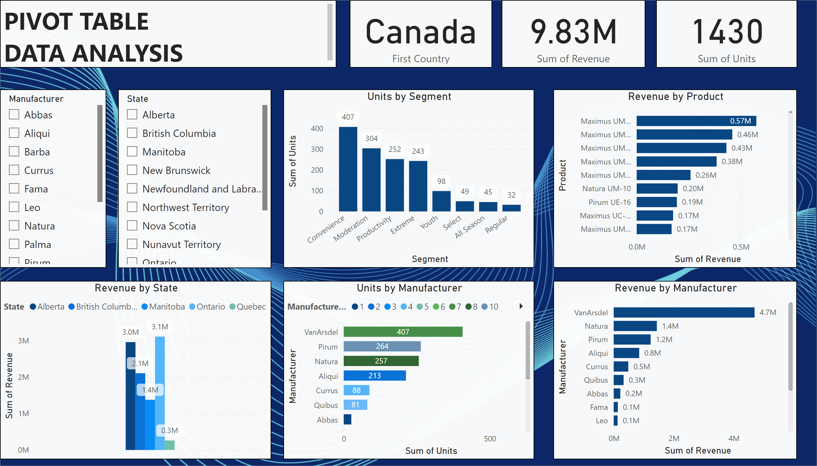
Dashboard
Notes:
Revenue by Manufacturer
No alt text provided
Units by Manufacturer
No alt text provided
Revenue by State
No alt text provided
Revenue by Product
No alt text provided
Units by Segment
No alt text provided
card
No alt text provided
card
No alt text provided
slicer
No alt text provided
slicer
No alt text provided
card
No alt text provided
textbox
No alt text provided

Slide 3
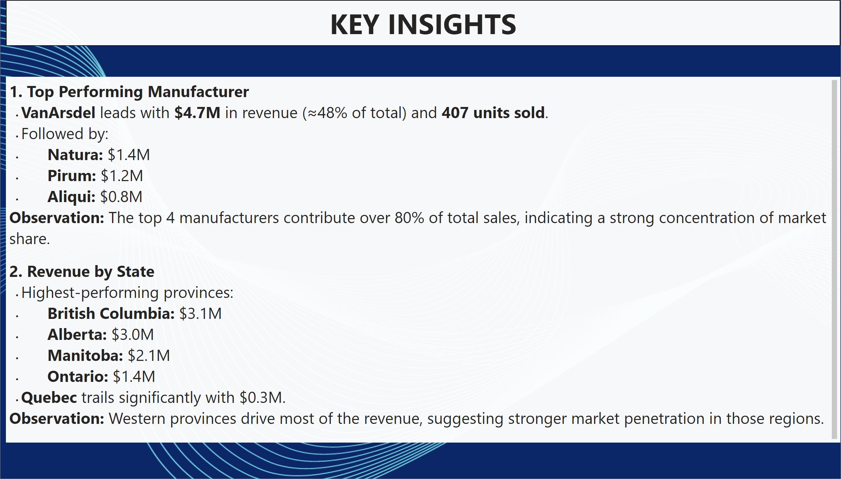
Summary note
Notes:
textbox
No alt text provided
textbox
No alt text provided

Slide 4
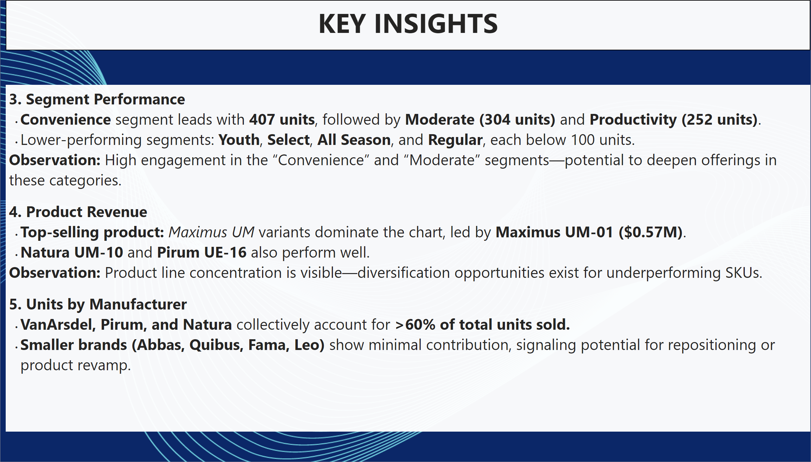
Summary note
Notes:
textbox
No alt text provided
textbox
No alt text provided

Slide 5
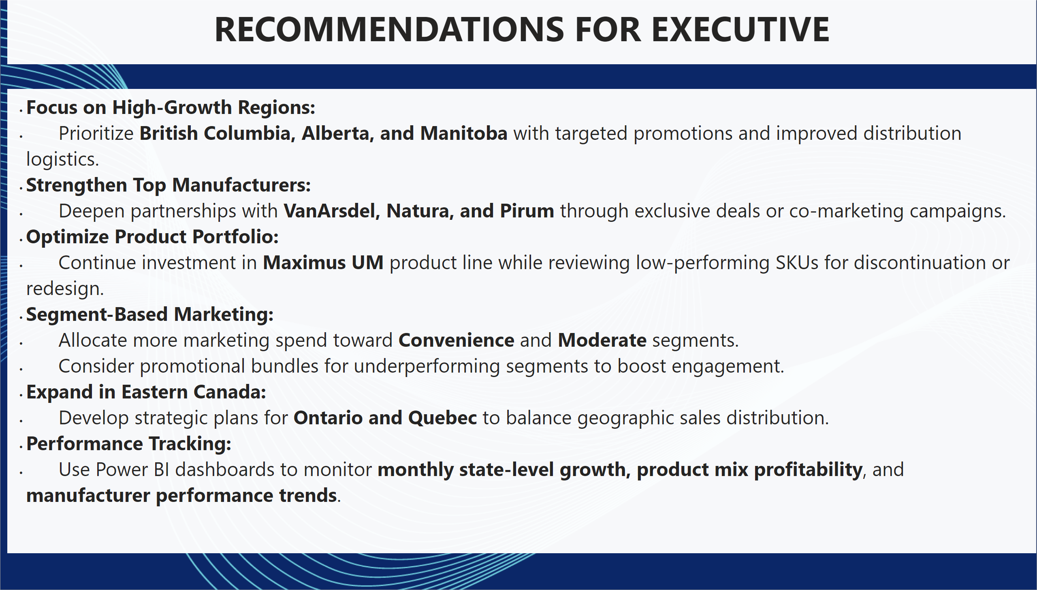
Recommendations
Notes:
textbox
No alt text provided
textbox
No alt text provided

